Slide 1
C# Tutorial
C# (C-Sharp) is a programming language developed by Microsoft that runs on the .NET Framework.
C# is used to develop web apps, desktop apps, mobile apps, games and much more.

Slide 2
What is C#?
What is C#?​
C# is pronounced "C-Sharp".​
It is an object-oriented programming language created by Microsoft that runs on the .NET Framework.​
C# has roots from the C family, and the language is close to other popular languages like C++ and Java.​
The first version was released in year 2002. The latest version, C# 8, was released in September 2019.​
C# is used for:​
Mobile applications​
Desktop applications​
Database applications​
And much, much more!​
Why Use C#?
It is one of the most popular programming language in the world
It is easy to learn and simple to use
It has a huge community support
C# is an object oriented language which gives a clear structure to programs and allows code to be reused, lowering development costs
As C# is close to C, C++ and Java, it makes it easy for programmers to switch to C# or vice versa

Slide 3
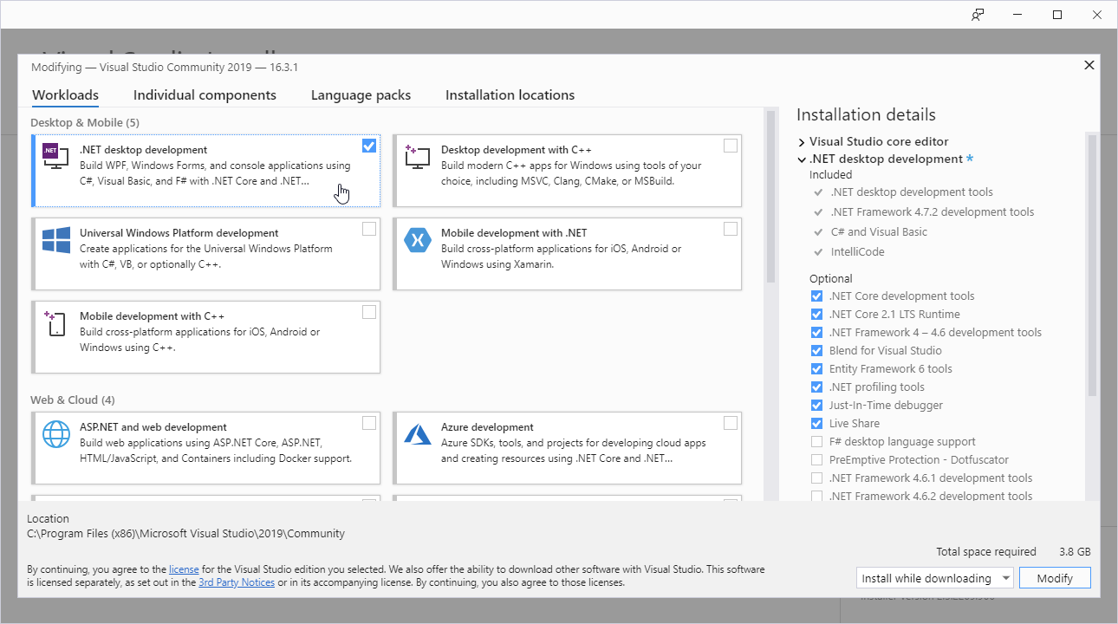
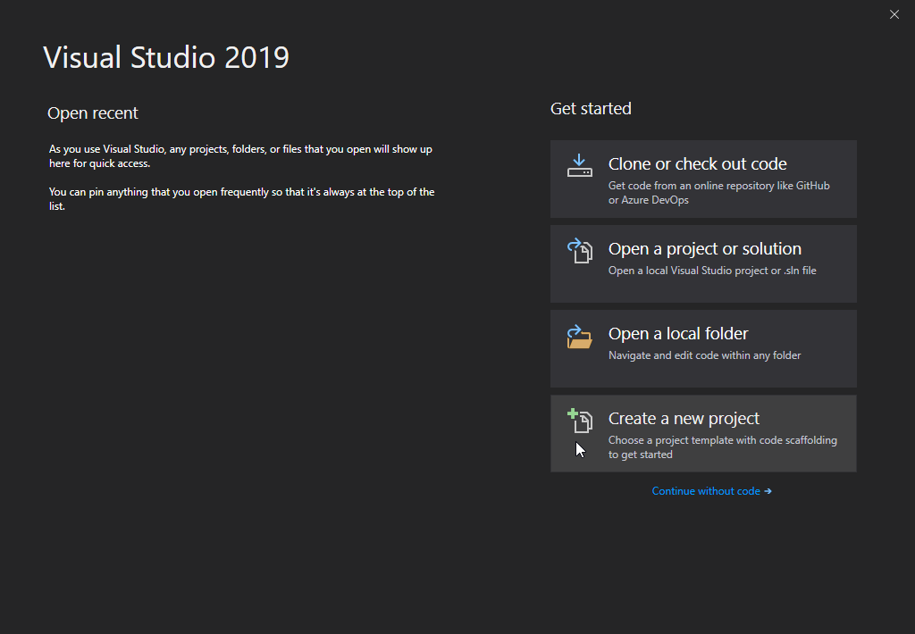
C# Get Started
C# Install
Once the Visual Studio Installer is downloaded and installed, choose the .NET workload and click on the Modify/Install button:
After the installation is complete, click on the Launch button to get started with Visual Studio.
On the start window, choose Create a new project:

Slide 4
C# Syntax
using System;
namespace HelloWorld {
class Program {
static void Main(string[] args)
{ Console.WriteLine("Hello World!"); } } }
Line 1: using System means that we can use classes from the System namespace.
Line 2: A blank line. C# ignores white space. However, multiple lines makes the code more readable.
Line 3: namespace is used to organize your code, and it is a container for classes and other namespaces.
Line 4: The curly braces {} marks the beginning and the end of a block of code.
Line 5: class is a container for data and methods, which brings functionality to your program. Every line of code that runs in C# must be inside a class. In our example, we named the class Program.

Slide 5
C# Output
To output values or print text in C#, you can use the WriteLine() method:
Example
Console.WriteLine("Hello World!");
The Write Method
There is also a Write() method, which is similar to WriteLine().
The only difference is that it does not insert a new line at the end of the output:
Example
Console.Write("Hello World! "); Console.Write("I will print on the same line.");

Slide 6
C# Comments
Comments can be used to explain C# code, and to make it more readable. It can also be used to prevent execution when testing alternative code.
Single-line Comments
Single-line comments start with two forward slashes (//).
Any text between // and the end of the line is ignored by C# (will not be executed).
This example uses a single-line comment before a line of code:
Example
// This is a comment Console.WriteLine("Hello World!");
C# Multi-line Comments
Multi-line comments start with /* and ends with */.
Any text between /* and */ will be ignored by C#.
This example uses a multi-line comment (a comment block) to explain the code:
Example
/* The code below will print the words Hello World to the screen, and it is amazing */ Console.WriteLine("Hello World!");

Slide 7
C# Variables
Variables are containers for storing data values.
In C#, there are different types of variables (defined with different keywords), for example:
int - stores integers (whole numbers), without decimals, such as 123 or -123
double - stores floating point numbers, with decimals, such as 19.99 or -19.99
char - stores single characters, such as 'a' or 'B'. Char values are surrounded by single quotes
string - stores text, such as "Hello World". String values are surrounded by double quotes
bool - stores values with two states: true or false

Slide 8
Declaring (Creating) Variables
To create a variable, you must specify the type and assign it a value:
Syntax
type variableName = value;
string name = "John"; Console.WriteLine(name);
int myNum = 15; Console.WriteLine(myNum);
double myDig = 15; Console.WriteLine(myDig);
char myLtr = 'a'; Console.WriteLine(myLtr);
bool myBol = 15; Console.WriteLine(myBol);

Slide 9
C# Type Casting
Implicit Casting (automatically) - converting a smaller type to a larger type size char -> int -> long -> float -> double
Explicit Casting (manually) - converting a larger type to a smaller size type double -> float -> long -> int -> char
int myInt = 9; double myDouble = myInt;
// Automatic casting: int to double Console.WriteLine(myInt);
// Outputs 9 Console.WriteLine(myDouble);
// Outputs 9
double myDouble = 9.78; int myInt = (int) myDouble;
// Manual casting: double to int Console.WriteLine(myDouble);
// Outputs 9.78 Console.WriteLine(myInt);
// Outputs 9

Slide 10
Type Conversion Methods
It is also possible to convert data types explicitly by using built-in methods, such as Convert.ToBoolean, Convert.ToDouble, Convert.ToString, Convert.ToInt32 (int) and Convert.ToInt64 (long):
int myInt = 10; double myDouble = 5.25; bool myBool = true; Console.WriteLine(Convert.ToString(myInt)); // convert int to string Console.WriteLine(Convert.ToDouble(myInt)); // convert int to double Console.WriteLine(Convert.ToInt32(myDouble)); // convert double to int Console.WriteLine(Convert.ToString(myBool)); // convert bool to string

Slide 11
C# User Input
Get User Input
You have already learned that Console.WriteLine() is used to output (print) values. Now we will use Console.ReadLine() to get user input.
// Type your username and press enter Console.WriteLine("Enter username:"); // Create a string variable and get user input from the keyboard and store it in the variable string userName = Console.ReadLine(); // Print the value of the variable (userName), which will display the input value Console.WriteLine("Username is: " + userName);
User Input and Numbers
The Console.ReadLine() method returns a string. Therefore, you cannot get information from another data type, such as int. The following program will cause an error:
Console.WriteLine("Enter your age:"); int age = Console.ReadLine(); Console.WriteLine("Your age is: " + age);
The error message will be something like this:
Cannot implicitly convert type 'string' to 'int'
Luckily, for you, you just learned from the previous chapter (Type Casting), that you can convert any type explicitly, by using one of the Convert.To methods:
Console.WriteLine("Enter your age:"); int age = Convert.ToInt32(Console.ReadLine()); Console.WriteLine("Your age is: " + age);

Slide 12
C# Operators
Operator | Name | Description | Example | Try it
+ | Addition | Adds together two values | x + y | Try it »
- | Subtraction | Subtracts one value from another | x - y | Try it »
* | Multiplication | Multiplies two values | x * y | Try it »
/ | Division | Divides one value by another | x / y | Try it »
% | Modulus | Returns the division remainder | x % y | Try it »
++ | Increment | Increases the value of a variable by 1 | x++ | Try it »
-- | Decrement | Decreases the value of a variable by 1 | x--
Operators are used to perform operations on variables and values.
In the example below, we use the + operator to add together two values:

Slide 13
# If ... Else
# Conditions and If Statements
C# supports the usual logical conditions from mathematics:
Less than: a < b
Less than or equal to: a <= b
Greater than: a > b
Greater than or equal to: a >= b
Equal to a == b
Not Equal to: a != b
You can use these conditions to perform different actions for different decisions.
C# has the following conditional statements:
Use if to specify a block of code to be executed, if a specified condition is true
Use else to specify a block of code to be executed, if the same condition is false
Use else if to specify a new condition to test, if the first condition is false
Use switch to specify many alternative blocks of code to be executed

Slide 14
Syntax For if...else
if (condition) { // block of code to be executed if the condition is True }
if (20 > 18) { Console.WriteLine("20 is greater than 18"); }
if (condition) { // block of code to be executed if the condition is True } else { // block of code to be executed if the condition is False }
int time = 20; if (time < 18) { Console.WriteLine("Good day."); } else { Console.WriteLine("Good evening."); }

Slide 15
C# Switch Statements
switch(expression) { case x: // code block break; case y: // code block break; default: // code block break; }
This is how it works:
The switch expression is evaluated once
The value of the expression is compared with the values of each case
If there is a match, the associated block of code is executed
The break and default keywords will be described later in this chapter
The example below uses the weekday number to calculate the weekday name:

Slide 16
The break Keyword
The default Keyword
int day = 4; switch (day) { case 1: Console.WriteLine("Monday"); break; case 2: Console.WriteLine("Tuesday"); break; case 3: Console.WriteLine("Wednesday"); break; case 4: Console.WriteLine("Thursday"); break; case 5: Console.WriteLine("Friday"); break; case 6: Console.WriteLine("Saturday"); break; case 7: Console.WriteLine("Sunday"); break; } // Outputs "Thursday" (day 4)
When C# reaches a break keyword, it breaks out of the switch block.
This will stop the execution of more code and case testing inside the block.
When a match is found, and the job is done, it's time for a break. There is no need for more testing.
The default Keyword
The default keyword is optional and specifies some code to run if there is no case match:

Slide 17
Loops
Loops can execute a block of code as long as a specified condition is reached.
Loops are handy because they save time, reduce errors, and they make code more readable.
C# For Loop
When you know exactly how many times you want to loop through a block of code, use the for loop instead of a while loop:
Syntax
for (statement 1; statement 2; statement 3) { // code block to be executed }
Statement 1 is executed (one time) before the execution of the code block.
Statement 2 defines the condition for executing the code block.
Statement 3 is executed (every time) after the code block has been executed.
C# While Loop
The while loop loops through a block of code as long as a specified condition is True:
Syntax
while (condition) { // code block to be executed }
The Do/While Loop
The do/while loop is a variant of the while loop. This loop will execute the code block once, before checking if the condition is true, then it will repeat the loop as long as the condition is true.
Syntax
do { // code block to be executed } while (condition);

Slide 18
C# Break and Continue
This example jumps out of the loop when i is equal to 4:
Example
for (int i = 0; i < 10; i++) { if (i == 4) { break; } Console.WriteLine(i); }
This example skips the value of 4:
Example
for (int i = 0; i < 10; i++) { if (i == 4) { continue; } Console.WriteLine(i); }
You have already seen the break statement used in an earlier chapter of this tutorial. It was used to "jump out" of a switch statement.
The break statement can also be used to jump out of a loop.
C# Continue
The continue statement breaks one iteration (in the loop), if a specified condition occurs, and continues with the next iteration in the loop.

Slide 19
C# Arrays
We have now declared a variable that holds an array of strings.
To insert values to it, we can use an array literal - place the values in a comma-separated list, inside curly braces:
string[] cars = {"Volvo", "BMW", "Ford", "Mazda"};
To create an array of integers, you could write:
int[] myNum = {10, 20, 30, 40};
Example :-
Access the Elements of an Array
You access an array element by referring to the index number.
This statement accesses the value of the first element in cars:
Example
string[] cars = {"Volvo", "BMW", "Ford", "Mazda"}; Console.WriteLine(cars[0]); // Outputs Volvo
Create an Array
Arrays are used to store multiple values in a single variable, instead of declaring separate variables for each value.
To declare an array, define the variable type with square brackets:
string[] cars;

Slide 20
C# Methods
Create a Method
A method is defined with the name of the method, followed by parentheses (). C# provides some pre-defined methods, which you already are familiar with, such as Main(), but you can also create your own methods to perform certain actions:
Example
Create a method inside the Program class:
class Program { static void MyMethod() { // code to be executed } }
Example Explained
MyMethod() is the name of the method
static means that the method belongs to the Program class and not an object of the Program class. You will learn more about objects and how to access methods through objects later in this tutorial.
void means that this method does not have a return value. You will learn more about return values later in this chapter
A method is a block of code which only runs when it is called.
You can pass data, known as parameters, into a method.
Methods are used to perform certain actions, and they are also known as functions.
Why use methods? To reuse code: define the code once, and use it many times.

Slide 21
C# Method Parameters
Example
static void MyMethod(string fname) { Console.WriteLine(fname + " Refsnes"); } static void Main(string[] args) { MyMethod("Liam"); MyMethod("Jenny"); MyMethod("Anja"); } // Liam Refsnes // Jenny Refsnes // Anja Refsnes
Parameters and Arguments
Information can be passed to methods as parameter. Parameters act as variables inside the method.
They are specified after the method name, inside the parentheses. You can add as many parameters as you want, just separate them with a comma.
The following example has a method that takes a string called fname as parameter. When the method is called, we pass along a first name, which is used inside the method to print the full name:

Slide 22
Default Parameter Value
You can also use a default parameter value, by using the equals sign (=). If we call the method without an argument, it uses the default value ("Norway"):
Example
static void MyMethod(string country = "Norway") { Console.WriteLine(country); } static void Main(string[] args) { MyMethod("Sweden"); MyMethod("India"); MyMethod(); MyMethod("USA"); } // Sweden // India // Norway // USA

Slide 23
Multiple Parameters
You can have as many parameters as you like:
Example
static void MyMethod(string fname, int age) { Console.WriteLine(fname + " is " + age); } static void Main(string[] args) { MyMethod("Liam", 5); MyMethod("Jenny", 8); MyMethod("Anja", 31); } // Liam is 5 // Jenny is 8 // Anja is 31

Slide 24
Return Values
The void keyword, used in the examples above, indicates that the method should not return a value. If you want the method to return a value, you can use a primitive data type (such as int or double) instead of void, and use the return keyword inside the method:
Example
static int MyMethod(int x) { return 5 + x; } static void Main(string[] args) { Console.WriteLine(MyMethod(3)); } // Outputs 8 (5 + 3)

Slide 25
Named Arguments
It is also possible to send arguments with the key: value syntax.
That way, the order of the arguments does not matter:
Example
static void MyMethod(string child1, string child2, string child3) { Console.WriteLine("The youngest child is: " + child3);a } static void Main(string[] args) { MyMethod(child3: "John", child1: "Liam", child2: "Liam"); } // The youngest child is: John

Slide 26
C# Method Overloading
Method Overloading
With Method overloading, multiple methods can have the same name with different parameters:
Example
int MyMethod(int x) float MyMethod(float x) double MyMethod(double x, double y)
Consider the following example, which have two methods that add numbers of different type:
Example
static int PlusMethodInt(int x, int y) { return x + y; } static double PlusMethodDouble(double x, double y) { return x + y; } static void Main(string[] args) { int myNum1 = PlusMethodInt(8, 5); double myNum2 = PlusMethodDouble(4.3, 6.26); Console.WriteLine("Int: " + myNum1); Console.WriteLine("Double: " + myNum2);

Slide 27
C# OOps Object Oriented Programming

Slide 28
C# - What is OOP?
OOP stands for Object-Oriented Programming.
Procedural programming is about writing procedures or methods that perform operations on the data, while object-oriented programming is about creating objects that contain both data and methods.
Object-oriented programming has several advantages over procedural programming:
OOP is faster and easier to execute
OOP provides a clear structure for the programs
OOP helps to keep the C# code DRY "Don't Repeat Yourself", and makes the code easier to maintain, modify and debug
OOP makes it possible to create full reusable applications with less code and shorter development time
Tip: The "Don't Repeat Yourself" (DRY) principle is about reducing the repetition of code. You should extract out the codes that are common for the application, and place them at a single place and reuse them instead of repeating it.

Slide 29
C# - What are Classes and Objects?
Classes and objects are the two main aspects of object-oriented programming.
Look at the following illustration to see the difference between class and objects:
class
Fruit
objects
Apple
Banana
Mango
Another example:
class
Car
objects
Volvo
Audi
Toyota
So, a class is a template for objects, and an object is an instance of a class.
When the individual objects are created, they inherit all the variables and methods from the class.

Slide 30
Classes and Objects
You learned from the previous chapter that C# is an object-oriented programming language.Everything in C# is associated with classes and objects, along with its attributes and methods. For example: in real life, a car is an object. The car has attributes, such as weight and color, and methods, such as drive and brake.
A Class is like an object constructor, or a "blueprint" for creating objects.
Create a Class
To create a class, use the class keyword:
Create a class named "Car" with a variable color:
class Car { string color = "red"; }
Create an Object
An object is created from a class. We have already created the class named Car, so now we can use this to create objects.
To create an object of Car, specify the class name, followed by the object name, and use the keyword new:
Example
Create an object called "myObj" and use it to print the value of color:
class Car { string color = "red"; static void Main(string[] args) { Car myObj = new Car(); Console.WriteLine(myObj.color); } }

Slide 31
Classes and Objects
You learned from the previous chapter that C# is an object-oriented programming language.Everything in C# is associated with classes and objects, along with its attributes and methods. For example: in real life, a car is an object. The car has attributes, such as weight and color, and methods, such as drive and brake.
A Class is like an object constructor, or a "blueprint" for creating objects.
Create a Class
To create a class, use the class keyword:
Create a class named "Car" with a variable color:
class Car { string color = "red"; }
Create an Object An object is created from a class. We have already created the class named Car, so now we can use this to create objects. To create an object of Car, specify the class name, followed by the object name, and use the keyword new:
Example
Create an object called "myObj" and use it to print the value of color:
class Car { string color = "red"; static void Main(string[] args) { Car myObj1 = new Car(); // Using Multiple Constructor At Same Time Car myObj2 = new Car(); Console.WriteLine(myObj1.color); Console.WriteLine(myObj2.color); } }

Slide 32
Class Members
Example
Create a Car class with three class members: two fields and one method.
// The class class MyClass { // Class members string color = "red"; // field int maxSpeed = 200; // field public void fullThrottle() // method { Console.WriteLine("The car is going as fast as it can!"); } }
This is especially useful when creating multiple objects of one class:
Fields and methods inside classes are often referred to as "Class Members":
class Car { string model; string color; int year; static void Main(string[] args) { Car Ford = new Car(); Ford.model = "Mustang"; Ford.color = "red"; Ford.year = 1969; Car Opel = new Car(); // you can access them by creating an object of the class, and by using the dot syntax (.). Opel.model = "Astra"; Opel.color = "white"; Opel.year = 2005; Console.WriteLine(Ford.model); Console.WriteLine(Opel.model); } }

Slide 33
C# Constructors
Constructors
A constructor is a special method that is used to initialize objects. The advantage of a constructor, is that it is called when an object of a class is created. It can be used to set initial values for fields:
Example
Create a constructor:
// Create a Car class class Car { public string model; // Create a field // Create a class constructor for the Car class public Car() { model = "Mustang"; // Set the initial value for model } static void Main(string[] args) { Car Ford = new Car(); // Create an object of the Car Class (this will call the constructor) Console.WriteLine(Ford.model); // Print the value of model } } // Outputs "Mustang"
Note that the constructor name must match the class name, and it cannot have a return type (like void or int).
Also note that the constructor is called when the object is created.
Constructor Also Save Times

Slide 34
C# Access Modifiers
Access Modifiers
By now, you are quite familiar with the public keyword that appears in many of our examples:
public string color;
The public keyword is an access modifier, which is used to set the access level/visibility for classes, fields, methods and properties.
C# has the following access modifiers:
There's also two combinations: protected internal and private protected.
For now, lets focus on public and private modifiers.
Modifier | Description
public | The code is accessible for all classes
private | The code is only accessible within the same class
protected | The code is accessible within the same class, or in a class that is inherited from that class. You will learn more about inheritance in a later chapter
internal | The code is only accessible within its own assembly, but not from another assembly. You will learn more about this in a later chapter

Slide 35
C# Access Modifiers
Private Modifier
If you declare a field with a private access modifier, it can only be accessed within the same class:
Example
class Car
{ private string model = "Mustang"; static void Main(string[] args) { Car myObj = new Car(); Console.WriteLine(myObj.model); } }
The output will be:
Mustang

Slide 36
C# Access Modifiers
Public Modifier
If you declare a field with a public access modifier, it is accessible for all classes:
Example
class Car { public string model = "Mustang"; } class Program { static void Main(string[] args) { Car myObj = new Car(); Console.WriteLine(myObj.model); } }
The output will be:
Mustang

Slide 37
C# Properties (Get and Set)
Properties and Encapsulation
Before we start to explain properties, you should have a basic understanding of "Encapsulation".
The meaning of Encapsulation, is to make sure that "sensitive" data is hidden from users. To achieve this, you must:
declare fields/variables as private
provide public get and set methods, through properties, to access and update the value of a private field

Slide 38
C# Properties
Properties
You learned from the previous chapter that private variables can only be accessed within the same class (an outside class has no access to it). However, sometimes we need to access them - and it can be done with properties.A property is like a combination of a variable and a method, and it has two methods: a get and a set method:
Example
class Person { private string name; // field public string Name // property { get { return name; } // get method set { name = value; } // set method } }
Example explaineda
The Name property is associated with the name field. It is a good practice to use the same name for both the property and the private field, but with an uppercase first letter.
The get method returns the value of the variable name.The set method assigns a value to the name variable. The value keyword represents the value we assign to the property.

Slide 39
Properties
Example
class Person { private string name; // field public string Name // property { get { return name; } // get method set { name = value; } // set method } }
Example explained
The Name property is associated with the name field. It is a good practice to use the same name for both the property and the private field, but with an uppercase first letter.
The get method returns the value of the variable name.
The set method assigns a value to the name variable. The value keyword represents the value we assign to the property.
You learned from the previous chapter that private variables can only be accessed within the same class (an outside class has no access to it). However, sometimes we need to access them - and it can be done with properties.
A property is like a combination of a variable and a method, and it has two methods: a get and a set method:

Slide 40
Properties and Encapsulation
Properties
You learned from the previous chapter that private variables can only be accessed within the same class
(an outside class has no access to it). However, sometimes we need to access them - and it can be done with properties.
A property is like a combination of a variable and a method, and it has two methods: a get and a set method:
Example
class Person { private string name; // field public string Name // property { get { return name; } // get method set { name = value; } // set method } }
Example explained
The Name property is associated with the name field. It is a good practice to use the same name for both the property and the private field, but with an uppercase first letter.
The get method returns the value of the variable name.
The set method assigns a value to the name variable. The value keyword represents the value we assign to the property.
Before we start to explain properties, you should have a basic understanding of "Encapsulation".
The meaning of Encapsulation, is to make sure that "sensitive" data is hidden from users. To achieve this, you must:
declare fields/variables as private
provide public get and set methods, through properties, to access and update the value of a private field

Slide 41
Properties and Encapsulation
Why Encapsulation?
Better control of class members (reduce the possibility of yourself (or others) to mess up the code)
Fields can be made read-only (if you only use the get method), or write-only (if you only use the set method)
Flexible: the programmer can change one part of the code without affecting other parts
Increased security of data
class Person { private string name; // field public string Name // property { get { return name; } set { name = value; } } } class Program { static void Main(string[] args) { Person myObj = new Person(); myObj.Name = "Liam"; //The output will be: //Liam Console.WriteLine(myObj.Name); } }
Before we start to explain properties, you should have a basic understanding of "Encapsulation".
The meaning of Encapsulation, is to make sure that "sensitive" data is hidden from users. To achieve this, you must:
declare fields/variables as private
provide public get and set methods, through properties, to access and update the value of a private field

Slide 42
C# Inheritance
class Vehicle // base class (parent) { public string brand = "Ford"; // Vehicle field public void honk() // Vehicle method { Console.WriteLine("Tuut, tuut!"); } } class Car : Vehicle // derived class (child) { public string modelName = "Mustang"; // Car field } class Program { static void Main(string[] args) { // Create a myCar object Car myCar = new Car(); // Call the honk() method (From the Vehicle class) on the myCar object myCar.honk(); // Display the value of the brand field (from the Vehicle class) and the value of the modelName from the Car class Console.WriteLine(myCar.brand + " " + myCar.modelName); } }
Inheritance (Derived and Base Class)
In C#, it is possible to inherit fields and methods from one class to another. We group the "inheritance concept" into two categories:
Derived Class (child) - the class that inherits from another class
Base Class (parent) - the class being inherited from
To inherit from a class, use the : symbol.
In the example below, the Car class (child) inherits the fields and methods from the Vehicle class (parent):
Why And When To Use "Inheritance"?
- It is useful for code reusability: reuse fields and methods of an existing class when you create a new class.

Slide 43
C# Polymorphism
Polymorphism and Overriding Methods
Polymorphism means "many forms", and it occurs when we have many classes that are related to each other by inheritance.
Like we specified in the previous chapter; Inheritance lets us inherit fields and methods from another class. Polymorphism uses those methods to perform different tasks. This allows us to perform a single action in different ways.
For example, think of a base class called Animal that has a method called animalSound(). Derived classes of Animals could be Pigs, Cats, Dogs, Birds - And they also have their own implementation of an animal sound (the pig oinks, and the cat meows, etc.):

Slide 44
Example
lass Animal // Base class (parent) { public void animalSound() { Console.WriteLine("The animal makes a sound"); } } class Pig : Animal // Derived class (child) { public void animalSound() { Console.WriteLine("The pig says: wee wee"); } } class Dog : Animal // Derived class (child) { public void animalSound() { Console.WriteLine("The dog says: bow wow"); } }

Slide 45
C# Abstraction
Abstract Classes and Methods
Data abstraction is the process of hiding certain details and showing only essential information to the user. Abstraction can be achieved with either abstract classes or interfaces (which you will learn more about in the next chapter).
The abstract keyword is used for classes and methods:
Abstract class: is a restricted class that cannot be used to create objects (to access it, it must be inherited from another class).
Abstract method: can only be used in an abstract class, and it does not have a body. The body is provided by the derived class (inherited from).
An abstract class can have both abstract and regular methods:

Slide 46
Example
abstract class Animal { public abstract void animalSound(); public void sleep() { Console.WriteLine("Zzz"); } }
From the example above, it is not possible to create an object of the Animal class:
Animal myObj = new Animal(); // Will generate an error (Cannot create an instance of the abstract class or interface 'Animal')

Slide 47
C# Interface
Interfaces
Another way to achieve abstraction in C#, is with interfaces.
An interface is a completely "abstract class", which can only contain abstract methods and properties (with empty bodies):
Example
// interface interface Animal { void animalSound(); // interface method (does not have a body) void run(); // interface method (does not have a body) }
It is considered good practice to start with the letter "I" at the beginning of an interface, as it makes it easier for yourself and others to remember that it is an interface and not a class.
By default, members of an interface are abstract and public.
Note: Interfaces can contain properties and methods, but not fields.

Slide 48
C# Enum
An enum is a special "class" that represents a group of constants (unchangeable/read-only variables).
To create an enum, use the enum keyword (instead of class or interface), and separate the enum items with a comma:
Example
enum Level { Low, Medium, High }
You can access enum items with the dot syntax:
Level myVar = Level.Medium; Console.WriteLine(myVar);

Slide 49
C# Files
Method | Description
AppendText() | Appends text at the end of an existing file
Copy() | Copies a file
Create() | Creates or overwrites a file
Delete() | Deletes a file
Exists() | Tests whether the file exists
ReadAllText() | Reads the contents of a file
Replace() | Replaces the contents of a file with the contents of another file
WriteAllText() | Creates a new file and writes the contents to it. If the file already exists, it will be overwritten.
The File class has many useful methods for creating and getting information about files. For example:
Working With Files
The File class from the System.IO namespace, allows us to work with files:
Example
using System.IO; // include the System.IO namespace File.SomeFileMethod(); // use the file class with methods

Slide 50
# Exceptions - Try..Catch
C# Exceptions
When executing C# code, different errors can occur: coding errors made by the programmer, errors due to wrong input, or other unforeseeable things.
When an error occurs, C# will normally stop and generate an error message. The technical term for this is: C# will throw an exception (throw an error).
C# try and catch
The try statement allows you to define a block of code to be tested for errors while it is being executed.
The catch statement allows you to define a block of code to be executed, if an error occurs in the try block.
The try and catch keywords come in pairs:
Syntax
try { // Block of code to try } catch (Exception e) { // Block of code to handle errors }

